Slide 1
DOWN SYNDROME DETECTION USING ADVANCED MACHINE LEARNING ALGORITHMS
By:-
IOMP BATCH-IT
KARANGULA YESHWANTH REDDY(22261A1232)
KARTHIKEYA REDDY VELAGALA(22261A1233)
GUIDE:-
Dr. D. Vijaya Lakshmi

Slide 2
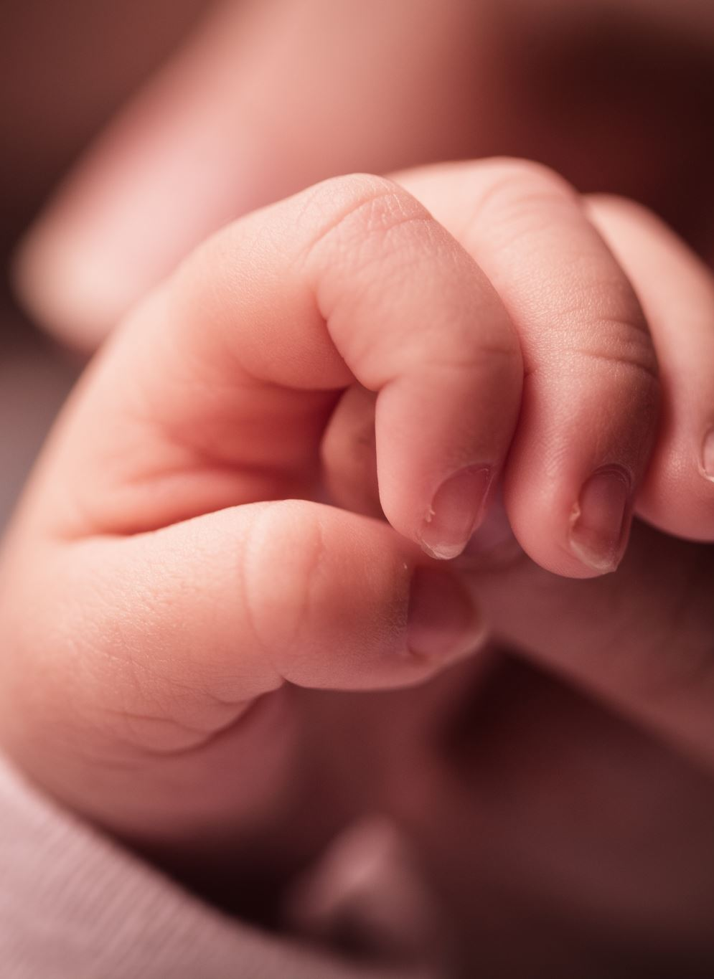
ABSRACT
The downs syndrome is a common birth defect occurring almost 1 in 700 new born babies, which can be detected during the development of fetus. The downs syndrome or trisomy 21 leads to slow learning capabilities and improper physical development of the human body. It is a genetic disorder and diagnosing it during early stages of pregnancy is very important. The downs syndrome occurs due to extra chromosomes or 3rd chromosome in the 21st pair of chromosomes hence is called trisomy 21. The downs syndrome can be detected by analyzing the protein contents present in the fetus. The advanced machine learning algorithms are incorporated to detect the syndrome which would perform better than the regular methods thereby increasing the accuracy of the procedure. The main focus is on finding the occurrence of downs syndrome with increased accuracy compared to regular ml approaches.

Slide 3
Introduction
Down syndrome (Trisomy 21) is caused by an extra chromosome 21, leading to intellectual disabilities and developmental delays. Early detection is crucial for effective intervention and better outcomes. Machine learning (ML) plays a key role in diagnosing Trisomy 21 by analyzing genetic data, such as chromosomal microarrays or next-generation sequencing (NGS), alongside clinical features. Since certain genes contribute to the disorder, parents who already have a child with Down syndrome face a higher likelihood of having another child with the condition if these genes are more dominant. Therefore, accurate detection and genetic analysis are essential for understanding and managing the recurrence risk.

Slide 4
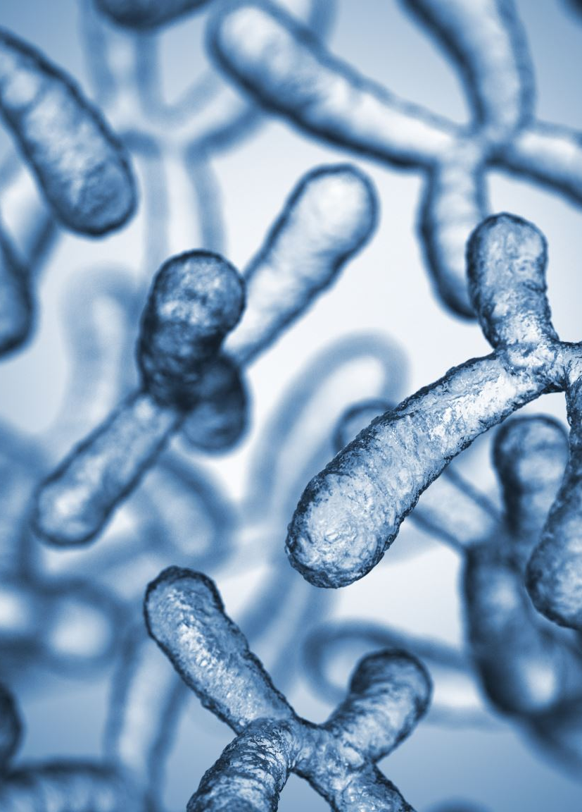
Existing System
Current methods for detecting Down syndrome rely heavily on clinical and cytogenetic techniques such as karyotyping, FISH (Fluorescence In Situ Hybridization), and non-invasive prenatal testing (NIPT). These approaches focus on identifying the presence of an extra chromosome 21 in the fetus, which is the genetic basis of Down syndrome. While accurate, these procedures are often labor-intensive, time-consuming, and costly. In some research settings, gene expression data is also used, where statistical methods like t-tests, ANOVA, or principal component analysis (PCA) are applied to find differentially expressed genes between affected and control groups. However, these traditional analytical techniques often struggle to model the complex, high-dimensional, and non-linear patterns present in genetic datasets, and they require extensive domain knowledge to interpret results effectively.

Slide 5
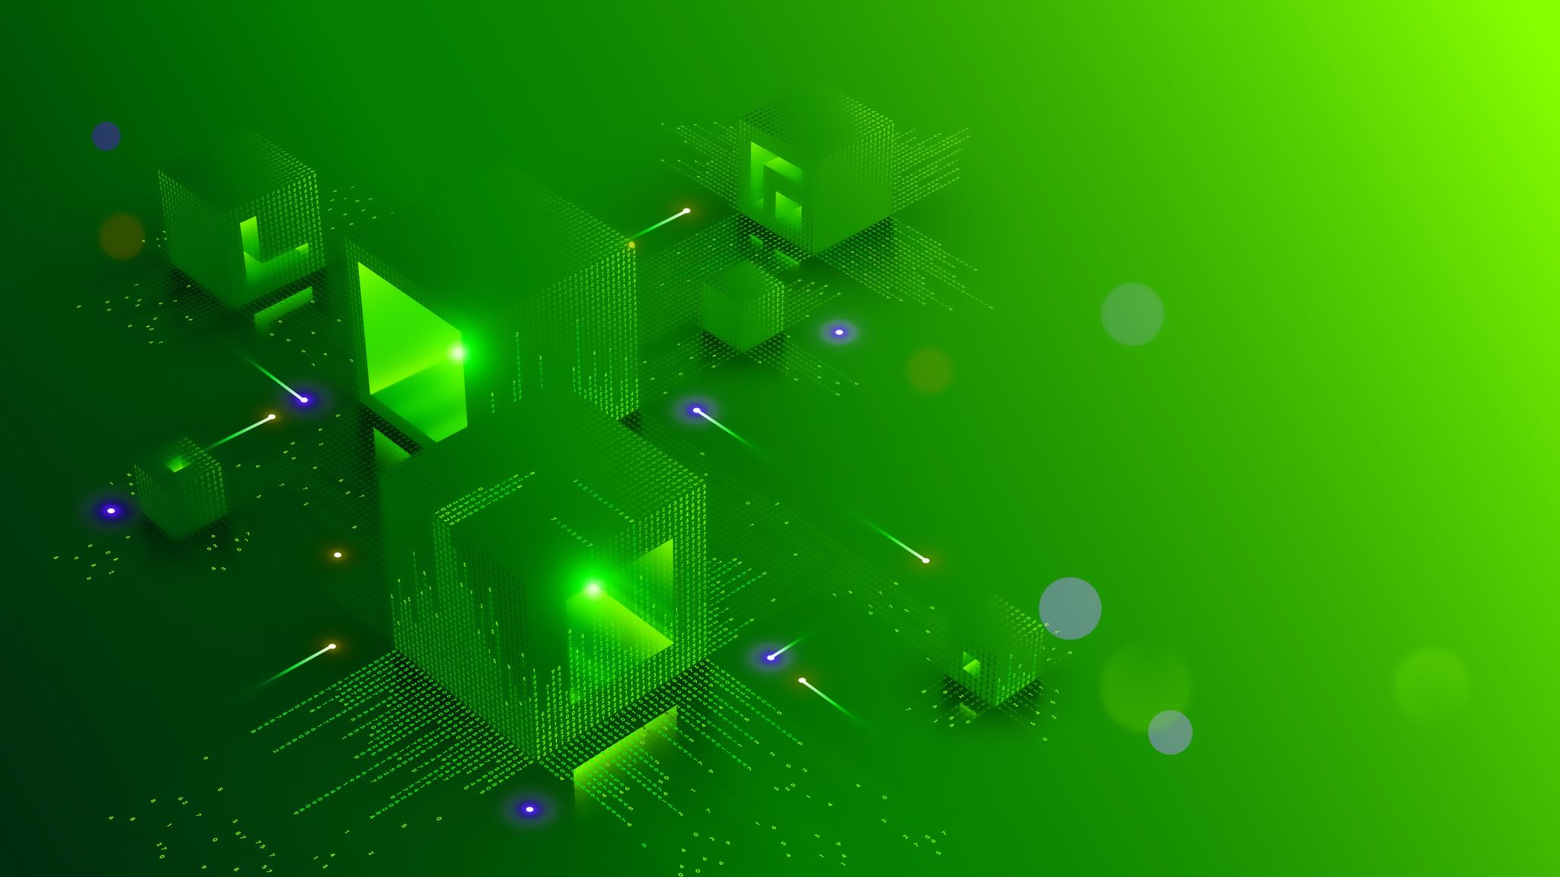
Proposed System
The proposed system aims to enhance the accuracy and efficiency of Down syndrome detection by applying advanced machine learning algorithms to gene expression data. Instead of relying solely on manual statistical analysis or cytogenetic observations, this system utilizes algorithms such as Random Forest, XGBoost, and LightGBM to automatically classify samples based on gene expression profiles. These models are capable of handling large, high-dimensional datasets, managing missing values, and learning complex relationships between genes without human bias. The proposed system enables faster diagnosis, higher accuracy, and scalability to larger datasets. Moreover, it offers the potential for identifying key genetic biomarkers associated with Down syndrome, supporting not only classification but also further biological insights. This shift from manual interpretation to intelligent automation represents a significant advancement in the field of genetic disorder detection.

Slide 6
Applications
Non-Invasive Prenatal Diagnosis
Clinical Decision Support Tool
Genetic Research and Biomarker Discovery

Slide 7
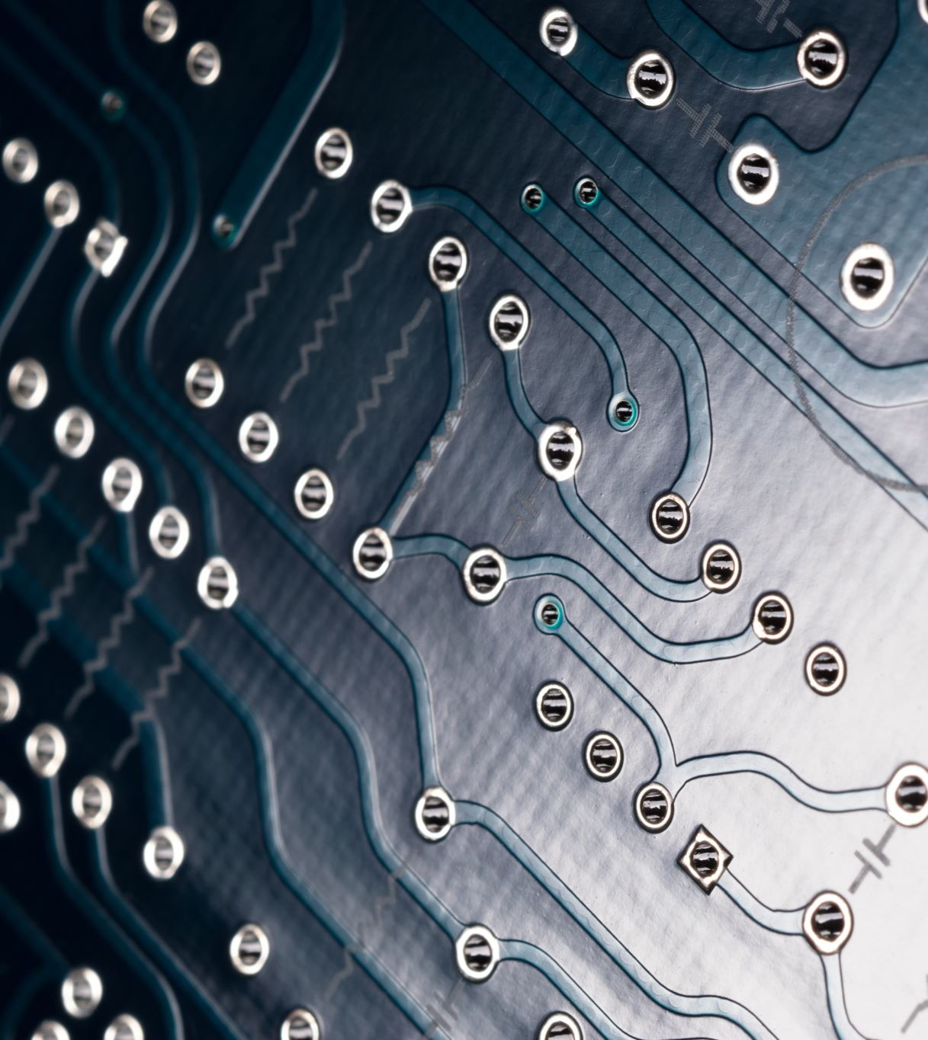
Hardware and software
Software Specifications:
-> Python IDLE -> Python Libraries: scikit-learn, LightGBM, XGBoost, Pandas, NumPy, Matplotlib, Seaborn, GEOparse, imblearn -> Front-end Tools: HTML, CSS, JavaScript -> IDE Environment: Python IDLE
Hardware Specifications:
-> Processor: Intel i5 or equivalent -> RAM: 8-16 GB -> Storage: 512 GB SSD

Slide 8
Literature Survey
Literature Survey on Down Syndrome Detection using Machine Learning
S. No | Author Names, Year | Journal / Conference Name & Publisher | Methodology / Algorithms Used | Merits | Demerits / Research Gaps
1 | Çelik et al., 2017 | 25th Signal Processing and Communications Applications Conference (SIU) | Machine Learning Techniques | Efficient gene estimation approach with decent accuracy | Lack of model generalization and scalability
2 | Li et al., 2019 | IEEE Access | Cascaded ML framework for imbalanced data | Accurate predictions with feature correlation handling | Complex design and high computational cost
3 | Ramanathan et al., 2018 | ICACCI – Int’l Conf. on Advances in Computing, Communications and Informatics | Probabilistic ML techniques | Probabilistic modeling improves prediction confidence | Needs real-time implementation and dataset validation
4 | Rodrigues et al. | Neuroimaging Review | Imaging-based ML analysis | Pictorial review offers medical imaging insights | Lacks automated classification pipeline
5 | Gupta et al. | ML in Intellectual & Developmental Disabilities Research | Inspired by neurological ML models | Cross-domain applicability and interpretability | Need for dedicated Down syndrome-specific datasets
6 | Raza et al. | Transfer Learning Facial Analysis | Deep learning & facial image analysis | High performance in diagnosis via facial cues | Needs diverse facial image datasets
7 | Cibrian et al. | Speech Recognition Limitations Study | Speech recognition ML techniques | Focused on communication enhancement | Performance drops in noisy conditions and real-time usage

Slide 9
Problem Statement
Down syndrome (Trisomy 21) is a common genetic disorder caused by an extra copy of chromosome 21, leading to developmental delays and intellectual disabilities. Current diagnostic methods like karyotyping and invasive prenatal testing (e.g., amniocentesis) are either costly, risky, or time-consuming. There is a growing need for a non-invasive, accurate, and efficient approach to detect Down syndrome early during pregnancy. The challenge lies in analyzing high-dimensional genetic data effectively to identify biomarkers associated with Trisomy 21. This project aims to apply advanced machine learning techniques—such as XGBoost, LightGBM, and Random Forest—to gene expression datasets for early and accurate detection of Down syndrome, improving diagnostic accuracy and aiding in timely intervention.

Slide 10
Objectives
Data Collection and Preprocessing
Application of Machine Learning Algorithms
Biomarker Identification
Improving Diagnostic Accuracy
Development of a Non-Invasive Detection Framework

Slide 11
Modules Description
Module | Description
Data Collection and Preprocessing Module | Load GSE6408 (Down Syndrome) and GSE9321 (Control) gene expression datasets using GEOparse; align genes across datasets; balance number of samples; handle missing values and apply normalization (StandardScaler); add noise for synthetic variation
Labeling and Classification Module | Create labels (1 for Down Syndrome, 0 for Normal); apply SMOTE to balance training data; train models using Random Forest, XGBoost, and LightGBM
Model Comparison and Optimization Module | Evaluate model performance using accuracy, precision, recall, F1-score; visualize confusion matrices; compare results across models
Prediction and Deployment Module | Use best model to predict on unseen samples; deploy model for further testing; optionally integrate with GUI or Web App
Visualization Module | Show performance metrics (accuracy, F1-score, etc.); display confusion matrix and feature importance graphs for each model

Slide 12
XGBoost
Input: Preprocessed and scaled gene expression dataset with labels Output: Classification performance (accuracy, confusion matrix, etc.)
Load and align Down Syndrome (GSE6408) and Control (GSE9321) gene expression data.
Add synthetic noise to reduce overfitting.
Apply StandardScaler to normalize the dataset.
Use train_test_split() to divide data into 80% training and 20% testing.
Apply SMOTE to balance class distribution in the training set.
Initialize XGBClassifier with:
use_label_encoder=False
eval_metric='logloss'
random_state=42
Fit the model on the resampled training data.
Predict on the test data.
Evaluate the model using:
accuracy_score
classification_report
confusion_matrix
Visualize the confusion matrix and top 10 feature importances

Slide 13
LightGBM
Input: Preprocessed and scaled gene expression dataset with labels Output: Classification performance (accuracy, confusion matrix, etc.)
Load and align Down Syndrome (GSE6408) and Control (GSE9321) gene expression data.
Add synthetic noise to reduce overfitting.
Apply StandardScaler to normalize the dataset.
Use train_test_split() to divide data into 80% training and 20% testing.
Apply SMOTE to balance class distribution in the training set.
Initialize LGBMClassifier with default settings and random_state=42.
Fit the model on the resampled training data.
Predict on the test data.
Evaluate the model using:
accuracy_score
classification_report
confusion_matrix
Visualize the confusion matrix and top 10 feature importances.

Slide 14
Random Forest
\Input: Preprocessed and scaled gene expression dataset with labels Output: Classification performance (accuracy, confusion matrix, etc.)
Load and align Down Syndrome (GSE6408) and Control (GSE9321) gene expression data.
Add synthetic noise to reduce overfitting.
Apply StandardScaler to normalize the dataset.
Use train_test_split() to divide data into 80% training and 20% testing.
Apply SMOTE to balance class distribution in the training set.
Fit the model on the resampled training data.
Predict on the test data.
Initialize RandomForestClassifier with default parameters and random_state=42.
Evaluate the model using:
accuracy_score
classification_report
confusion_matrix
Visualize the confusion matrix and top 10 feature importances.

Slide 15
References
E. Çelik, H. O. İlhan and A. Elbir, "Detection and estimation of down syndrome genes by machine learning techniques," 2017 25th Signal Processing and Communications Applications Conference (SIU), Antalya, Turkey, 2017, pp. 1-4, doi: 10.1109/SIU.2017.7960496.
L. Li, W. Liu, H. Zhang, Y. Jiang, X. Hu and R. Liu, "Down Syndrome Prediction Using a Cascaded Machine Learning Framework Designed for Imbalanced and Feature-correlated Data," in IEEE Access, vol. 7, pp. 97582-97593, 2019, doi: 10.1109/ACCESS.2019.2929681.
S. Ramanathan, M. Sangeetha, S. Talwai and S. Natarajan, "Probabilistic Determination Of Down's Syndrome Using Machine Learning Techniques," 2018 International Conference on Advances in Computing, Communications and Informatics (ICACCI), Bangalore, India, 2018, pp. 126-132, doi: 10.1109/ICACCI.2018.8554392.
Neuroimaging assessment in Down syndrome: a pictorial review Marta Rodrigues1*, Joana Nunes1, Sofia Figueiredo2, António Martins de Campos2 and Ana Filipa Geraldo1
Bringing machine learning to research on intellectual and developmental disabilities: taking inspiration from neurological diseases Chirag Gupta1,2, Pramod Chandrashekar1,2, Ting Jin1,2, Chenfeng He1,2, Saniya Khullar1,2, Qiang Chang1,3,4 and Daifeng Wang1,2,5*
Novel Transfer Learning Based Deep Features for Diagnosis of Down Syndrome in Children Using Facial Images ALI RAZA 1,KASHIF MUNIR 2,MUBARAKS. ALMUTAIRI 3,ANDRUKHSHANDASEHAR 1
Limitations in speech recognition for young adults with down syndrome Franceli L. Cibrian1 · Yingchen ’Yuki’ Chen1 · Kayla Anderson1 · Cecilia Marie Abrahamsson1 · Vivian Genaro Motti2

Slide 16

THANK YOU !!!

